Slide 1
ELECTRONIC VOTING MACHINE (work progress – Iv)
Course: CSE299(Junior Design), Section: 11, Faculty: ITN
Team Name: Team Venom
Name of the Members:
1.Tazbin Hossain Zadid – 1520683042
(tazbin.zadid@northsouth.edu)
2. Sadman Alam - 1610544042 (sadman.alam@northsouth.edu)

Slide 2
Introduction
We are making an Electronic Voting Machine as our junior design project. It is not a very small project and we’ll have to complete it before the end of the semester.
That’s why we have divided our work in some steps. This week, we will talk about what are the things we have done in our fourth step.

Slide 3
The FOURTH step
Last time, we bought the fingerprint module and constructed the breadboard set up.
This time, we’ve added some wires in their corresponding places and installed the Arduino Software. The software is important to run our machine. It will run through a particular code written in C.

Slide 4
Description of work
We have placed some wires in their corresponding places.
They will work as ground and VCC(power supply) provider to the push buttons.
We will add more wires in the upcoming weeks when we will add the Arduino UNO, LCD and fingerprint module.
But for now, we have kept our work limited to this.

Slide 5
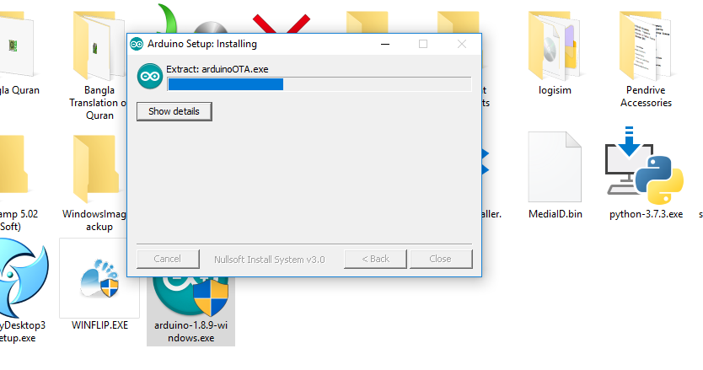
Description of work (continued)
We have also installed the Arduino Software for operating our system.
We have attached some screenshots of the installation as a proof of our work.

Slide 6
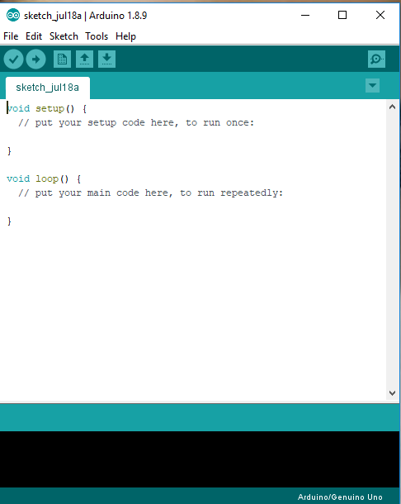
Description of work (continued)

Slide 7
Conclusion
For this week, our motive was to place some wires and install the Arduino Software. So, we are satisfied as we have completed our work.
Hopefully, step by step we will be able to complete our project.

Slide 8
THANK YOU VERY MUCH !!!!!!

